Slide 1
Time and Space Complexity

Slide 2
Analysis of Algorithm
An algorithm is a finite set of precise instructions for performing a computation or for solving a problem.
What is the goal of analysis of algorithms?
To compare algorithms mainly in terms of running time but also in terms of other factors (e.g., memory requirements, programmer's effort etc.)
What do we mean by running time analysis?
Determine how running time increases as the size of the problem increases.

Slide 3
Contd..
Time Complexity
Space Complexity

Slide 4
Contd..
The space complexity of an algorithm is the amount of memory it needs to run to completion.
The time complexity of an algorithm is the amount of computer time it needs to run to completion.

Slide 5
Space Complexity

Slide 6
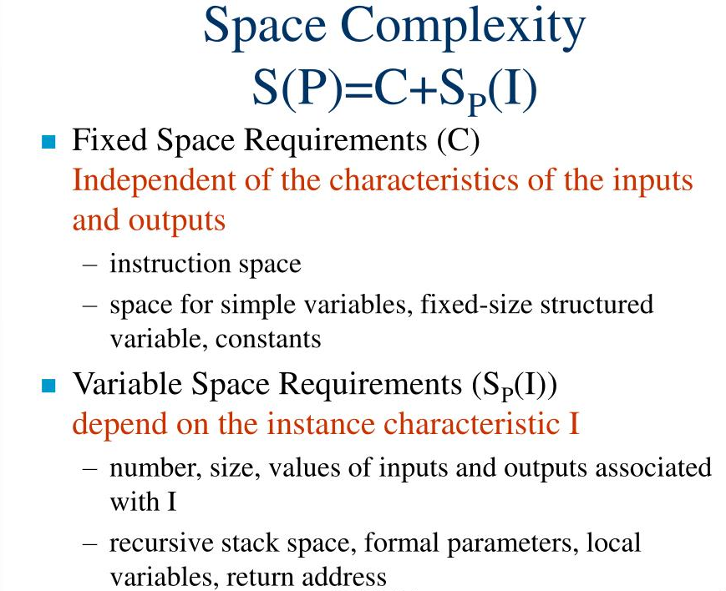

Slide 7
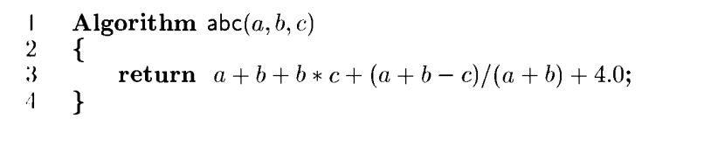
c=3 S_{P}=0
S(P)=3+0
S(P)=c+S_{P}(I)

Slide 8
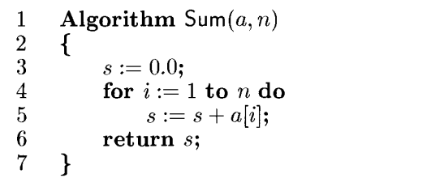
c=3 S_{P}(I)=n
S(P)=c+S_{P}(I)
S(P)>=(n+3)

Slide 9
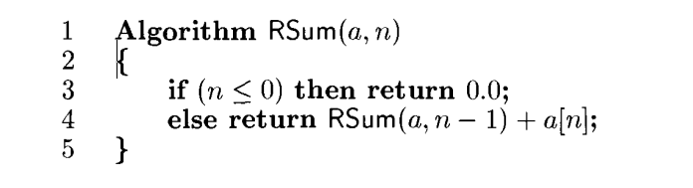
c=0 S_{P}(I)=3(n+1)
S(P)=c+S_{P}(I)
S_{P}>=3(n+1)

Slide 10
Time Complexity
The time T(P) taken by a program P is the sum of the compile time and the run (or execution)time.
The compile time does not depend on the instance characteristics.

Slide 11
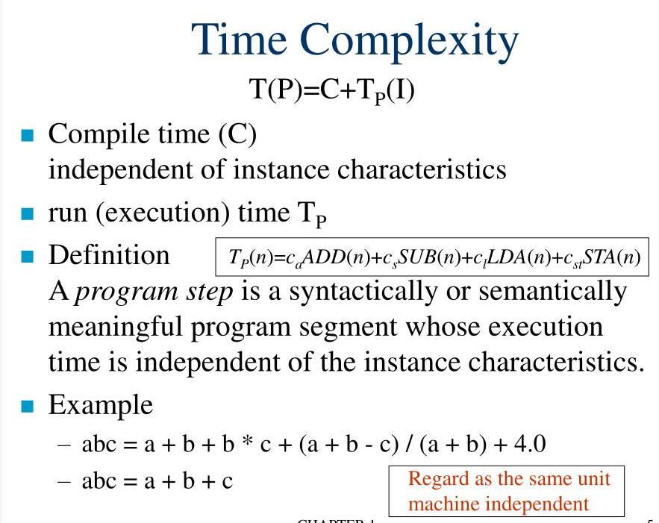

Slide 12
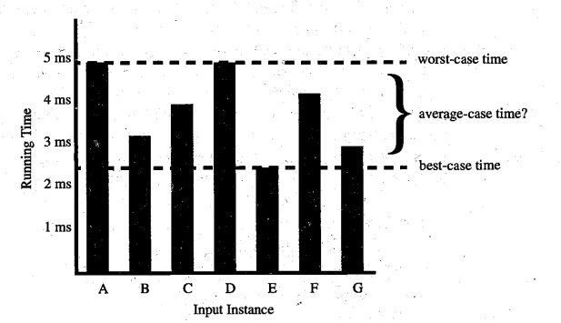
Time Complexity

Slide 13
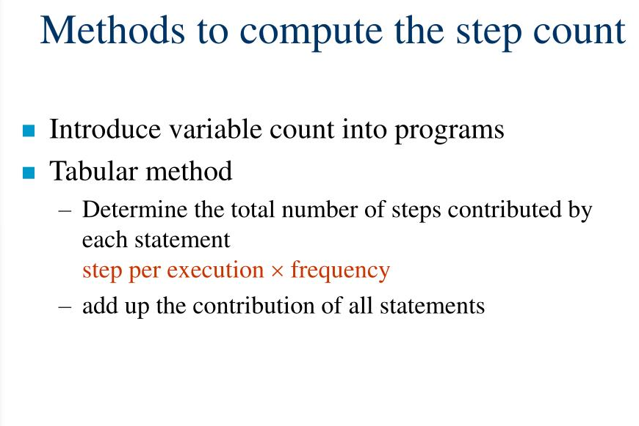

Slide 14
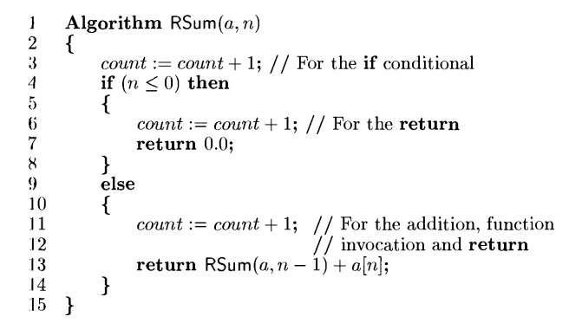
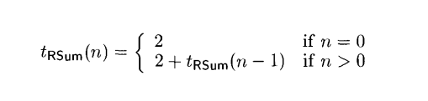
2n+2

Slide 15
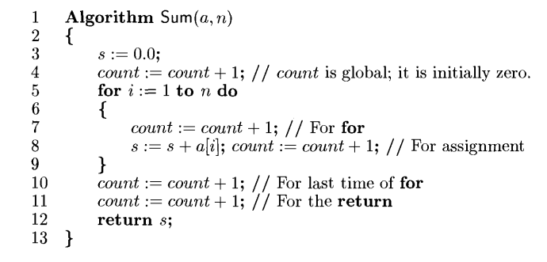
2n+3

Slide 16
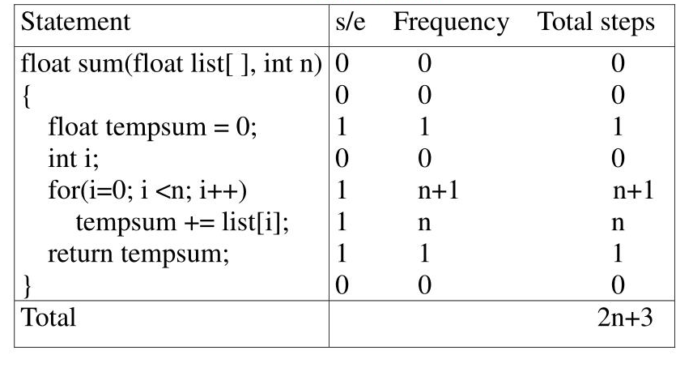
Tabular Method

Slide 17
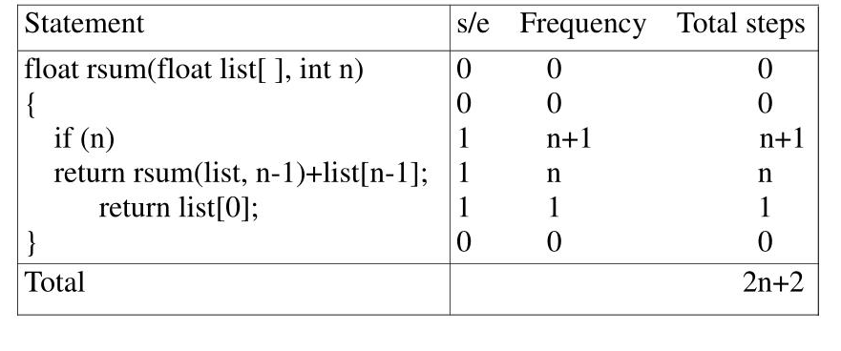
Example :2

Slide 18
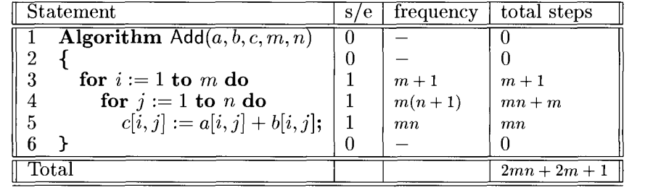
Example:3

Slide 19
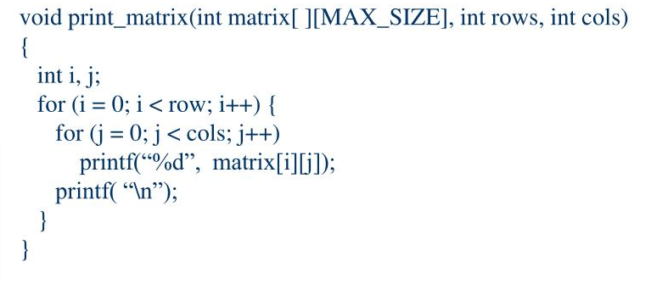
Exercise:1

Slide 20
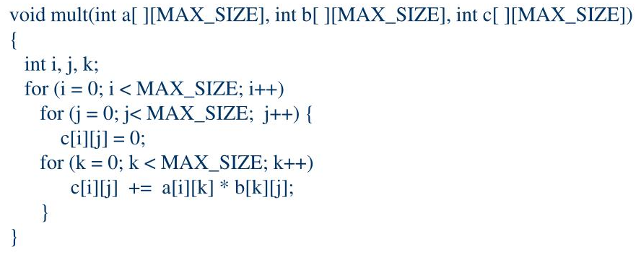
Exercise:2

Slide 21
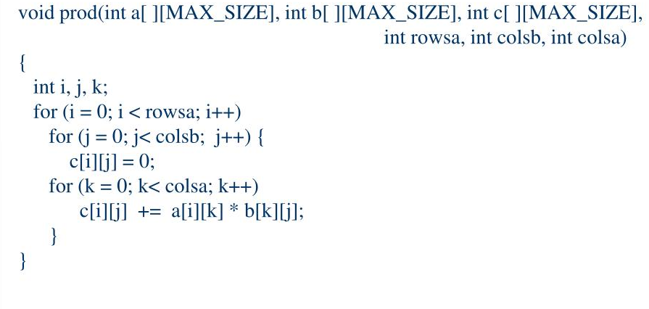
Exercise-3

Slide 22
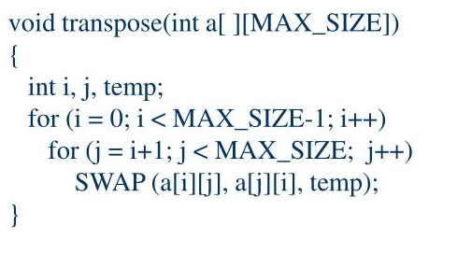
Exercise: 4

